Slide 1






Install WordPress on Localhost using XAMPP

Slide 2
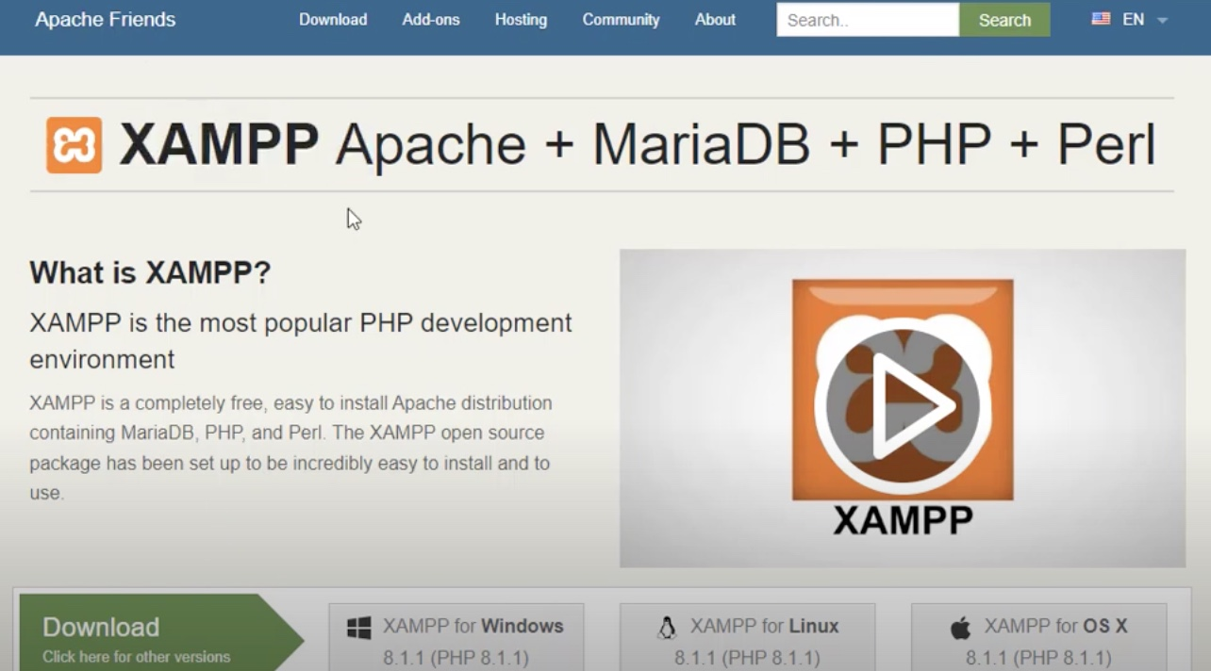
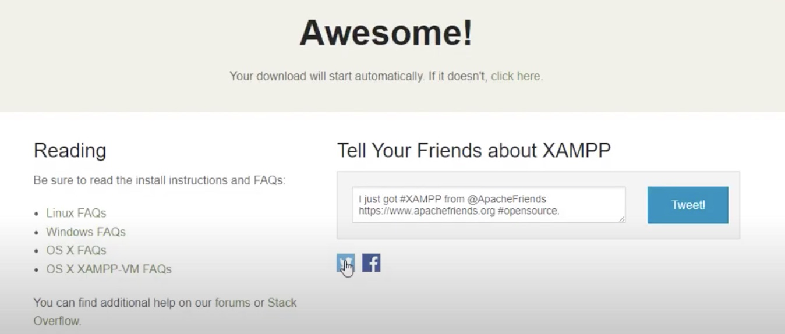
Step 1
Download XAMPP
Open your browser and go to apachefriends.org
Click Download XAMPP for your OS (Windows/Mac/Linux)

Slide 3
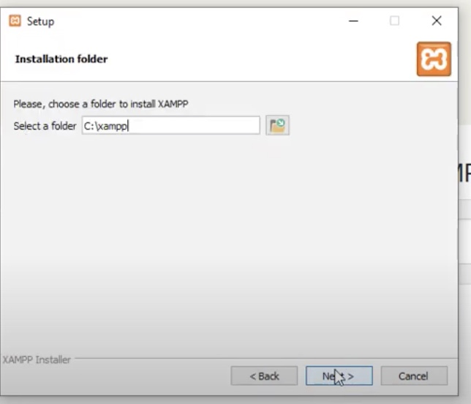
Step 2
Install XAMPP
Run the downloaded XAMPP installer.
Click Next through the prompts.
By default, XAMPP installs to C:\xampp (Windows) or /Applications/MAMP (Mac).

Slide 4
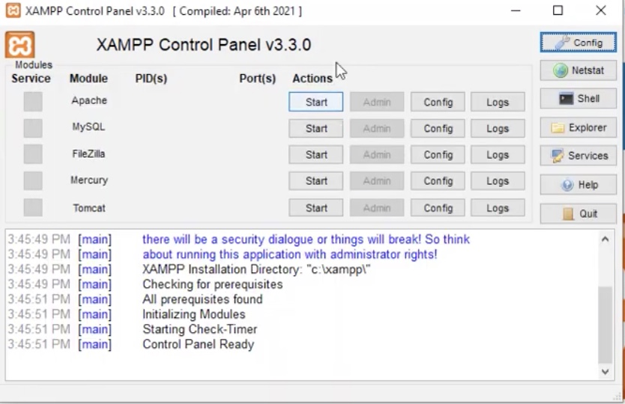
Step 3
XAMPP Control Panel
Launch XAMPP; you’ll see the Control Panel
The panel shows modules: Apache, MySQL, etc

Slide 5
Step 4
In your browser, go to wordpress.org, Click on “Get WordPress” and Download it
Extract the downloaded .zip file
Navigate to *C:\xampp\htdocs and create a folder with a name of your choice (e.g., Learnwithnimra)
Copy the wordpress folder files and paste it in “Learnwithnimra” folder
Download WordPress AND Extract

Slide 6
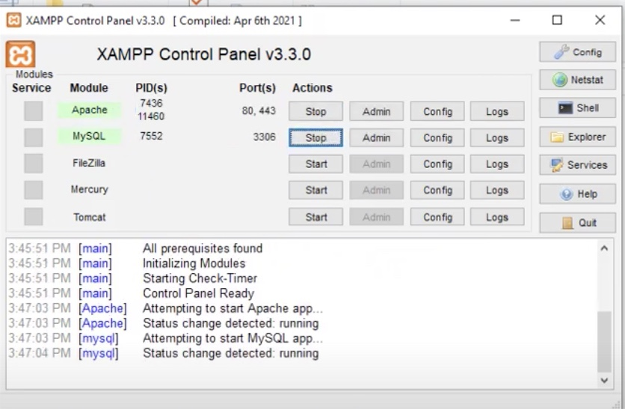
Step 5
Start Apache & MySQL
In XAMPP Control Panel, click Start next to Apache and MySQL
Ensure both modules show Running in green

Slide 7
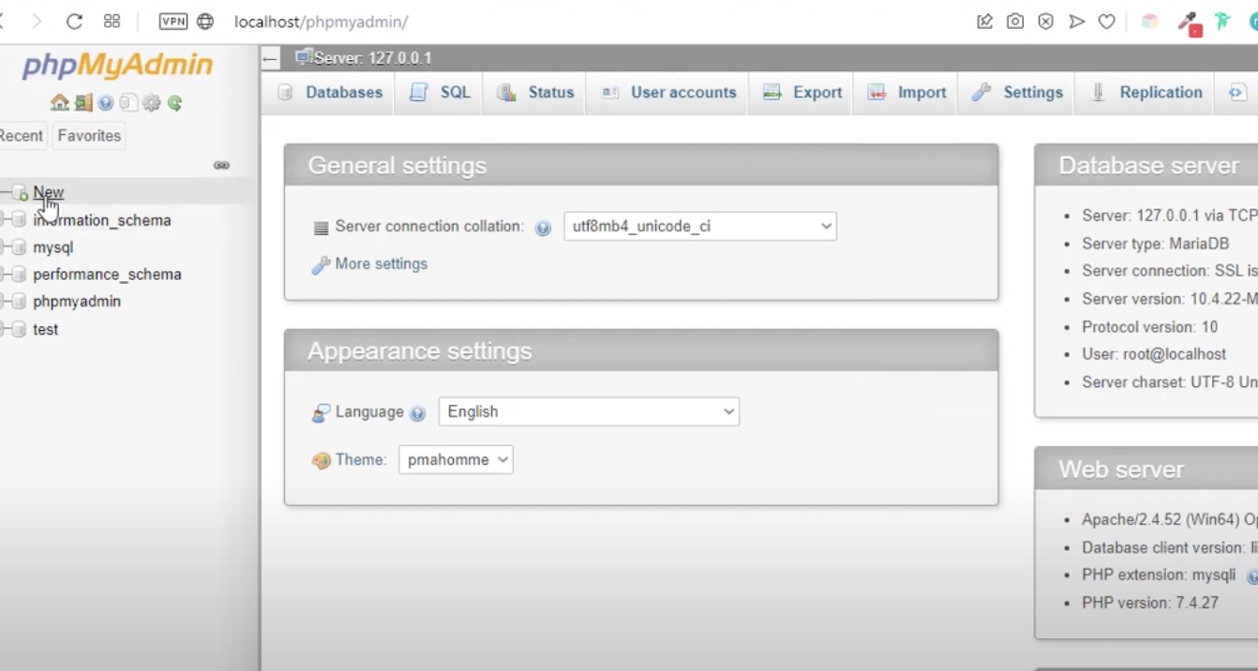
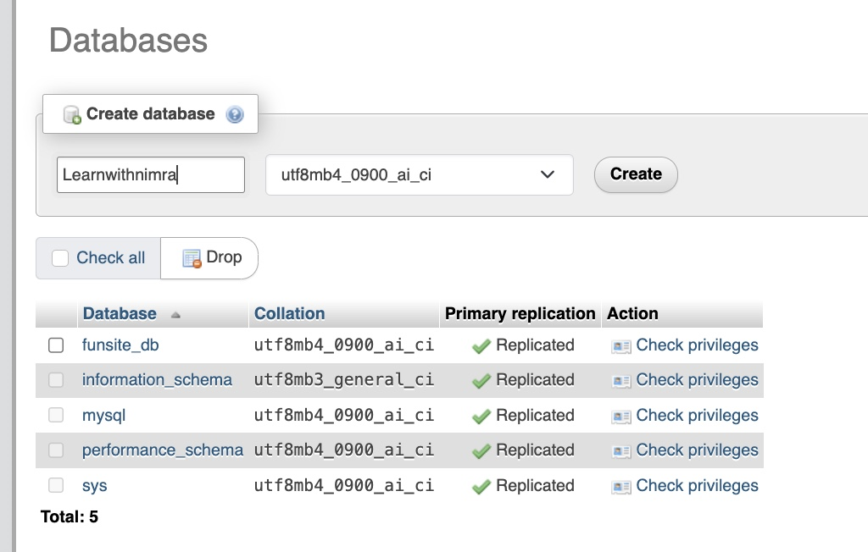
Step 6
Open phpMyAdmin
In your browser, go to “localhost/phpmyadmin” and the phpMyAdmin dashboard appears
Click New in phpMyAdmin
Enter Database name matching your folder (e.g., Learnwithnimra)
Click Create

Slide 8
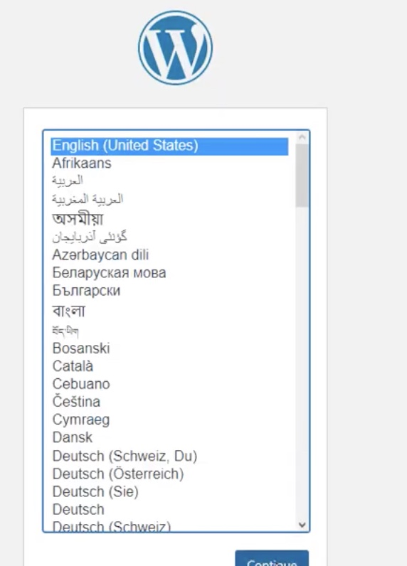
Step 7
Run WordPress Installer
Go to localhost/Learnwithnimra in your browser
Select English and click Continue
Click Let’s go!

Slide 9
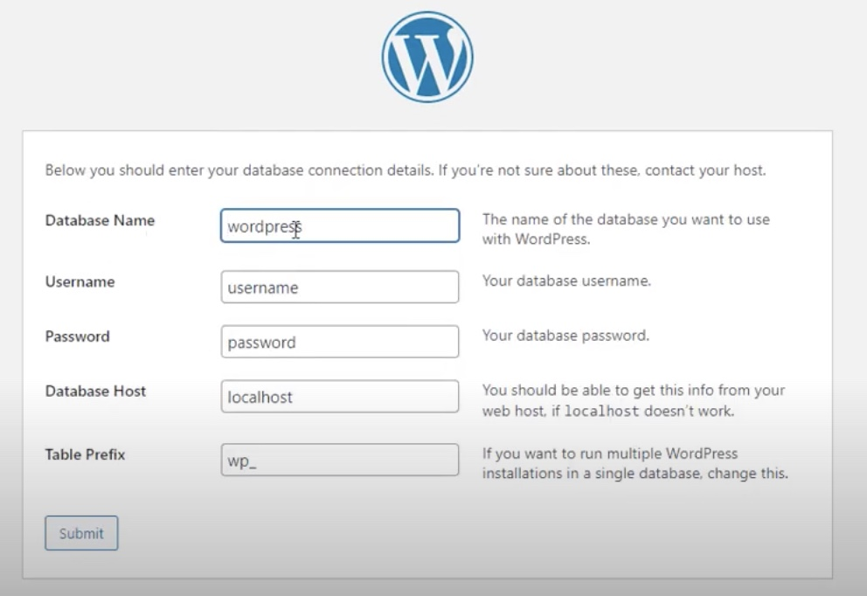
Step 8
Database Connection
Enter the following:
Database Name: Learnwithnimra
Username: root
Password: (leave blank)
Database Host: localhost
Table Prefix: wp_
2. Click Submit

Slide 10
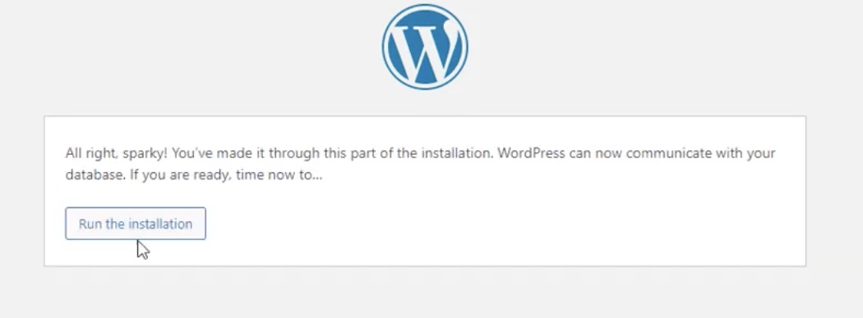
Step 9
Install WordPress
Once you click on submit, the following page will open
Click on, “Run the Installation”

Slide 11
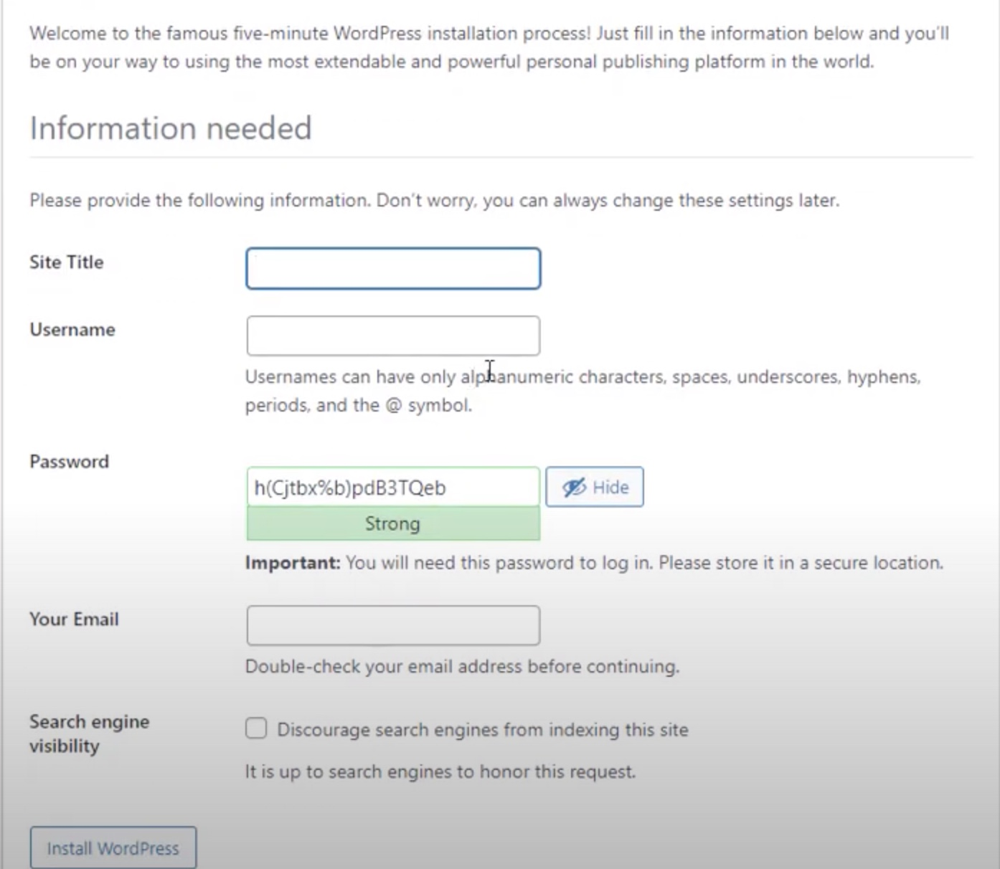
Step 10
Fill up all the Details
Fill in:
Site Title
Username (e.g., admin)
Password
Your Email
2. Click Install WordPress

Slide 12
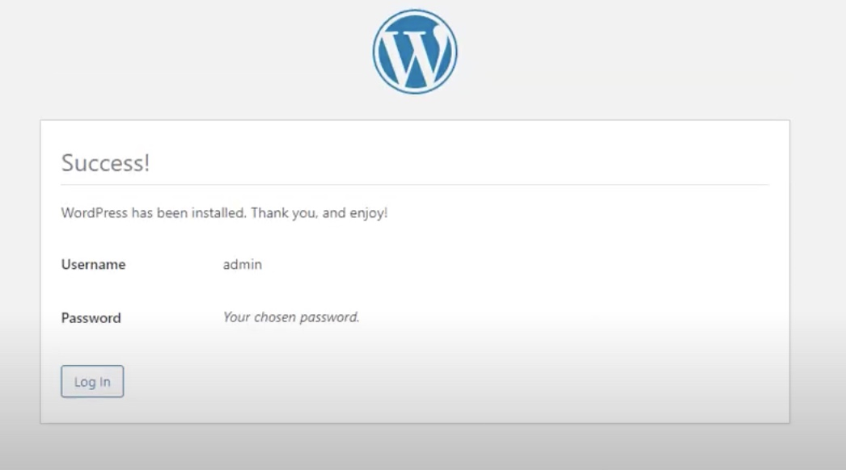
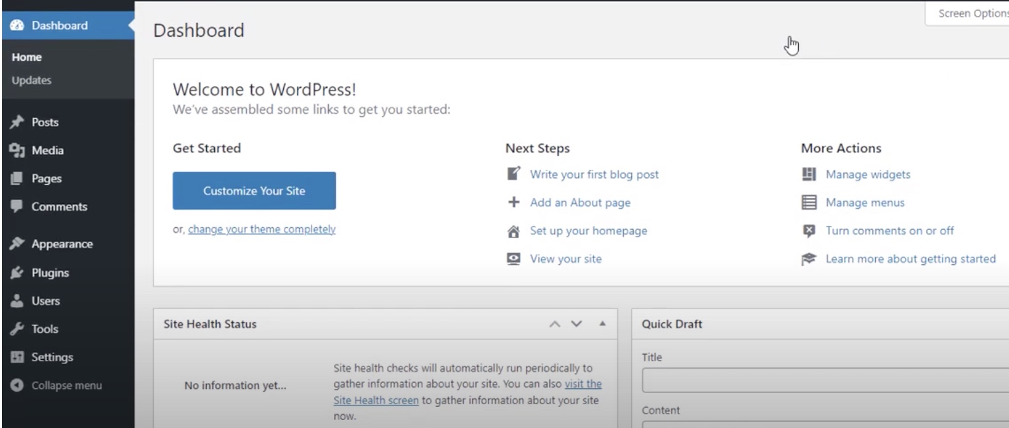
Step 11
Login to Dashboard
After installation, click Log In
Enter your WordPress Username and Password
The WordPress Dashboard opens

Slide 13
Step 11
Login to Dashboard
After installation, click Log In
Enter your WordPress Username and Password
The WordPress Dashboard opens

Slide 14
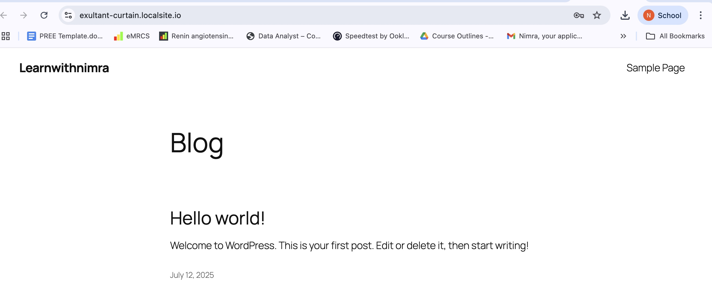
Site will open

Slide 15

“We’ve now explored two methods for running WordPress locally—using Local by Flywheel and XAMPP. It’s time to dive into WordPress itself : pick a theme, explore its features, and start customizing to make it your own!”

Slide 16
Applying Security on Your Website Through Wordfence

Slide 17
Applying Security on Your Website Through Wordfence
You’ve deployed WordPress in a live environment via cPanel/DirectAdmin
Your site is now mature - issues are rare, but when they occur, you handle them directly
In your WordPress Dashboard, go to Plugins → Add New
If any old security plugin exists, click Delete to remove it

Slide 18
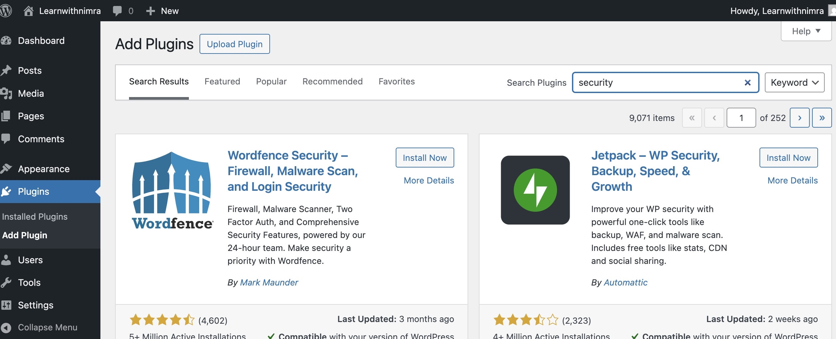
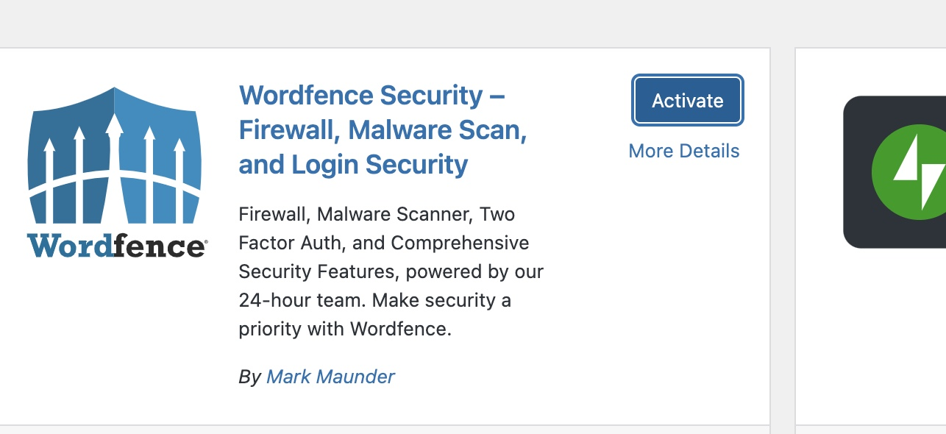
Step 1
Install Wordfence
In Add Plugins, search for security
Locate Wordfence Security
Click Install Now, then Activate

Slide 19
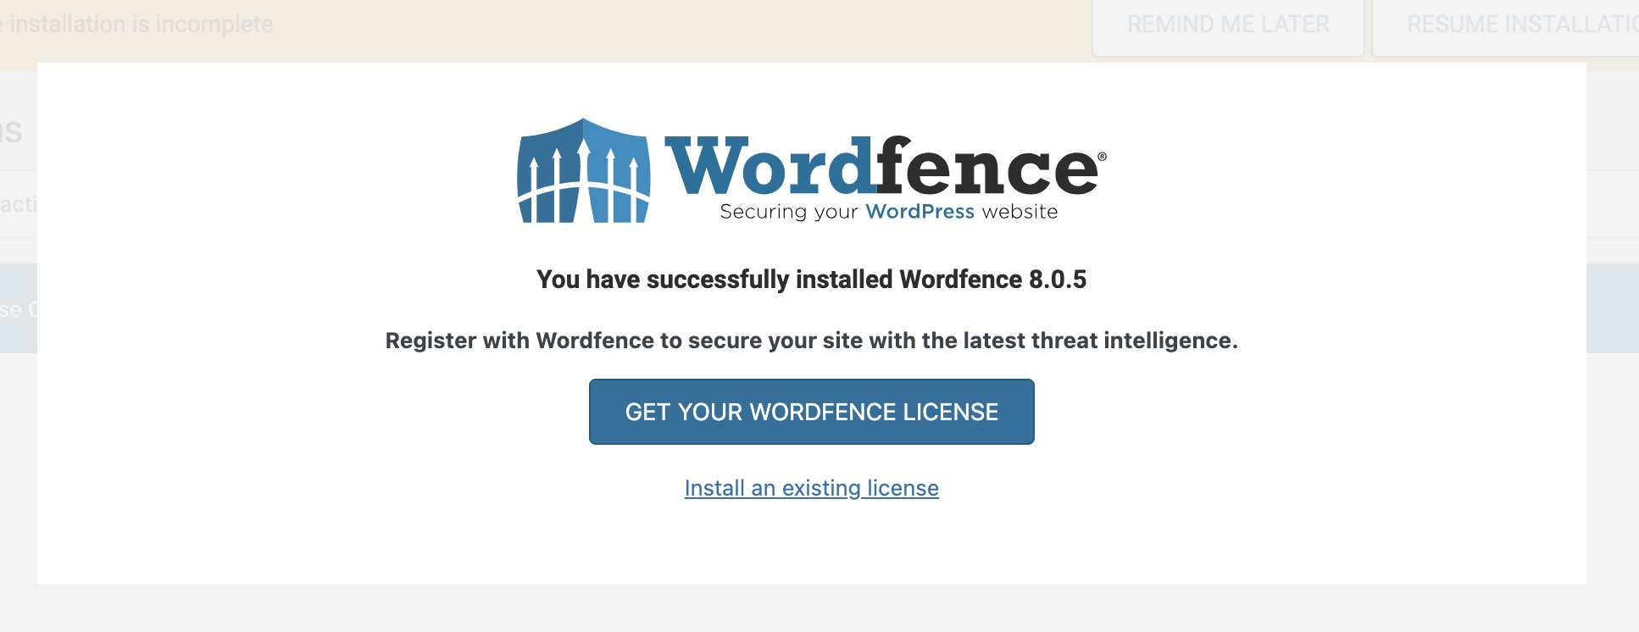
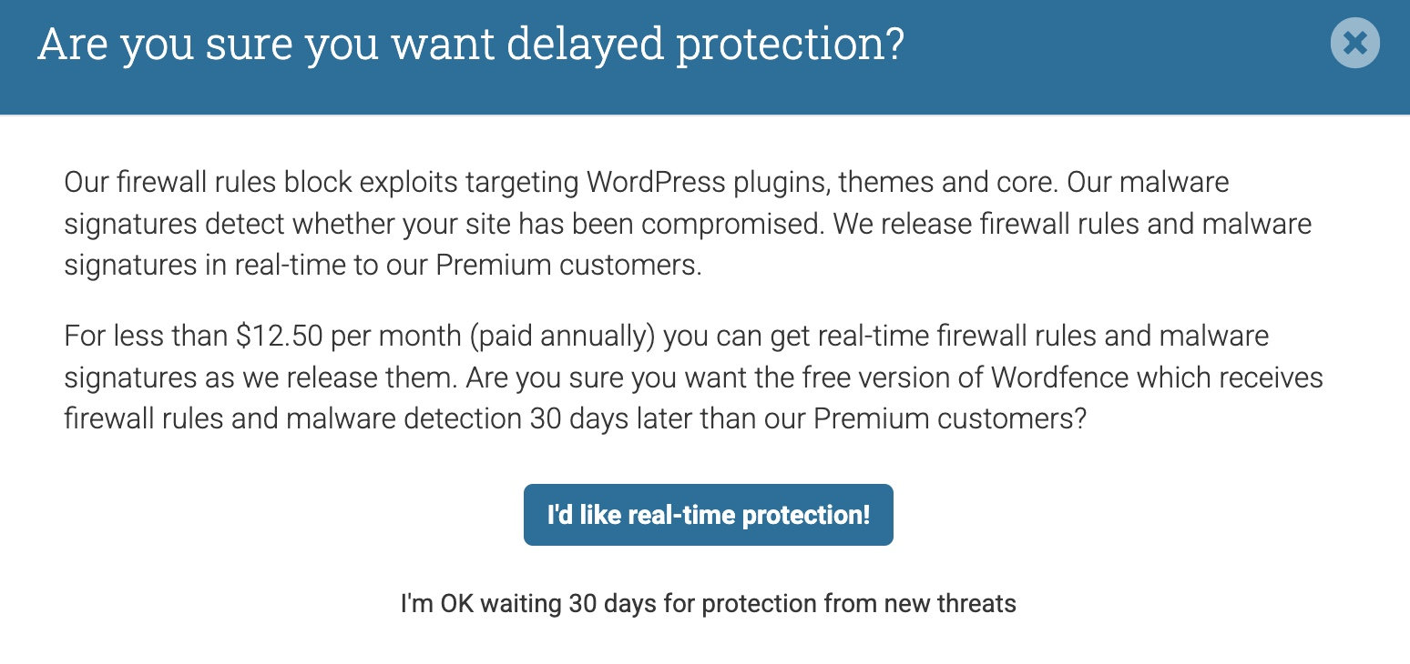
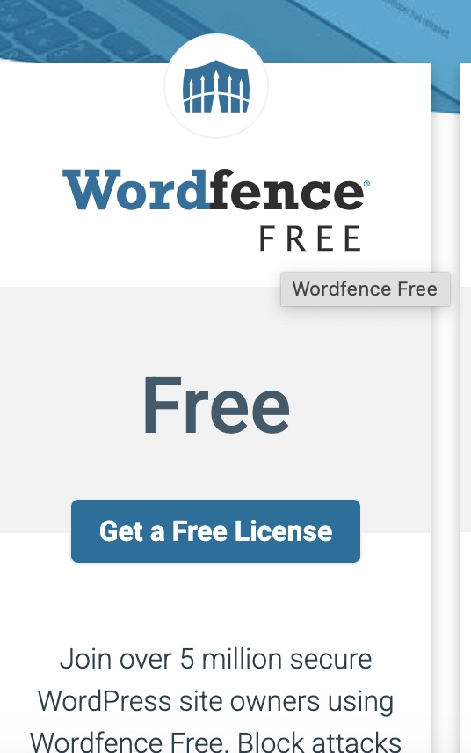
Step 2
Get Your License
After activation, click Get your Wordfence License
You’ll be redirected to Wordfence.com
Choose the Free Plan and select “I’m OK waiting 30 days for protection from new trends

Slide 20
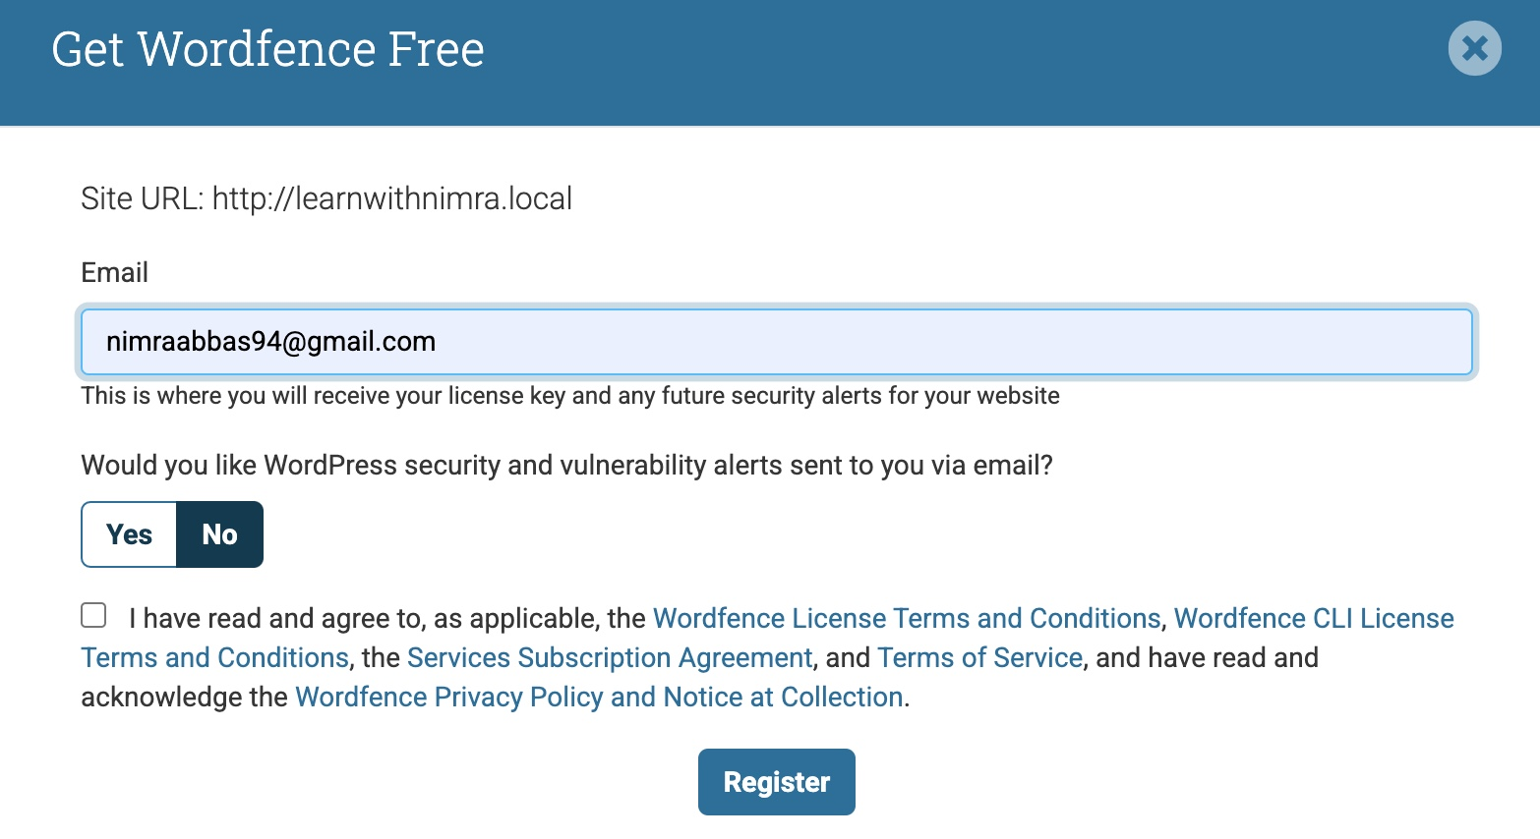
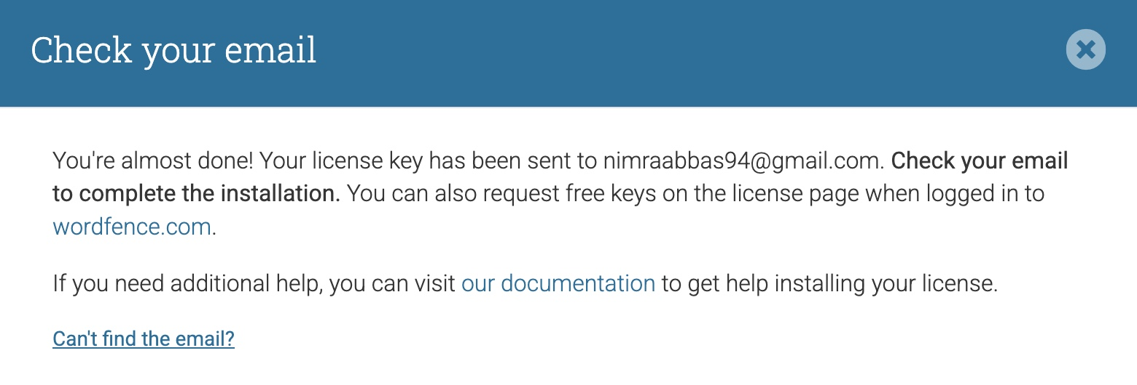
Step 3
Register & Install License
Enter your Email Address and click Register.
Check your email for the license key
In the email, click Install my License Automatically

Slide 21
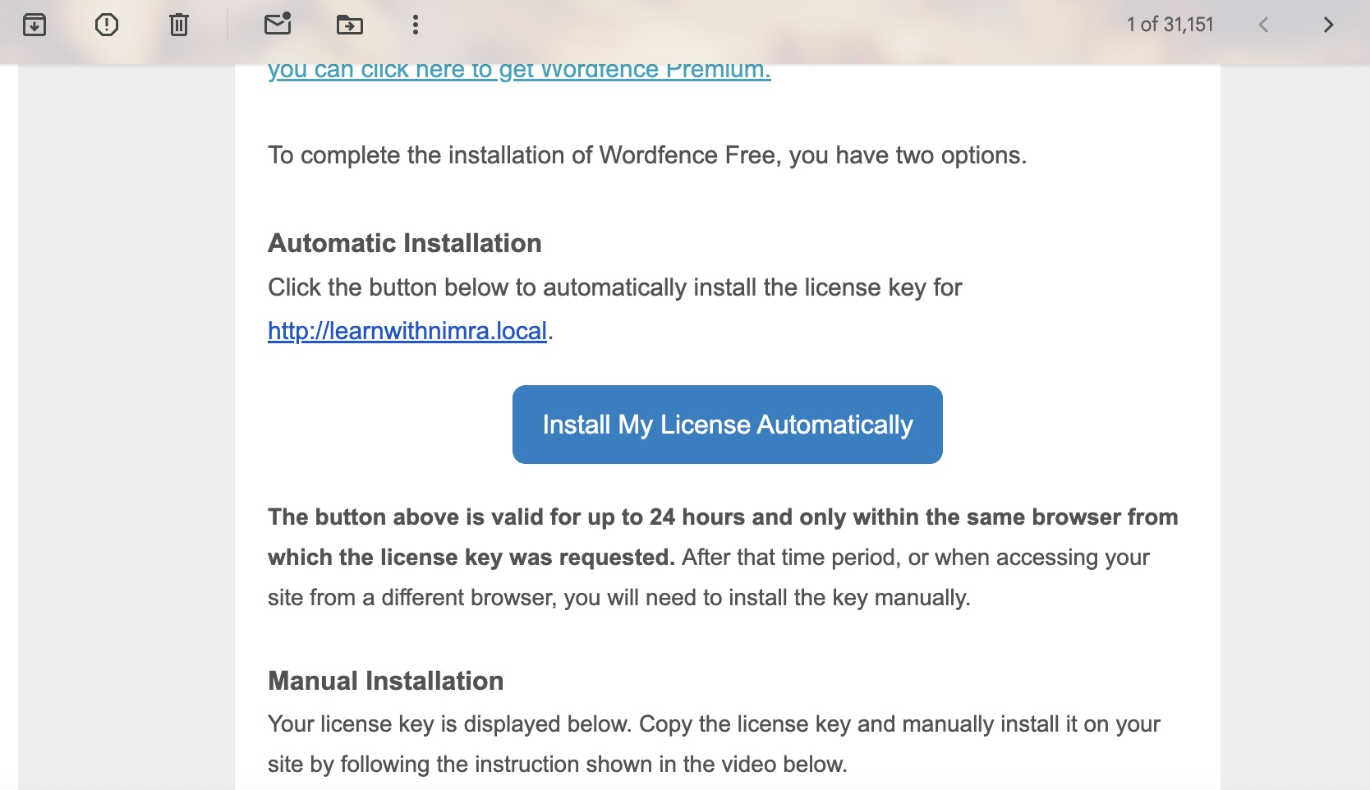
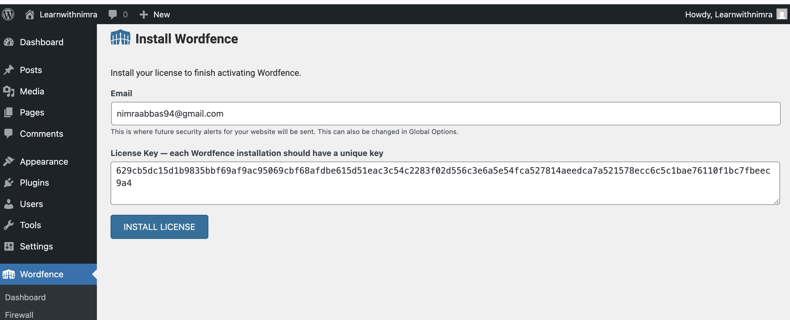
Step 4
Wordfence Dashboard
On the Wordfence page, click Install License
After installation, the Wordfence Dashboard appears with security status and alerts

Slide 22
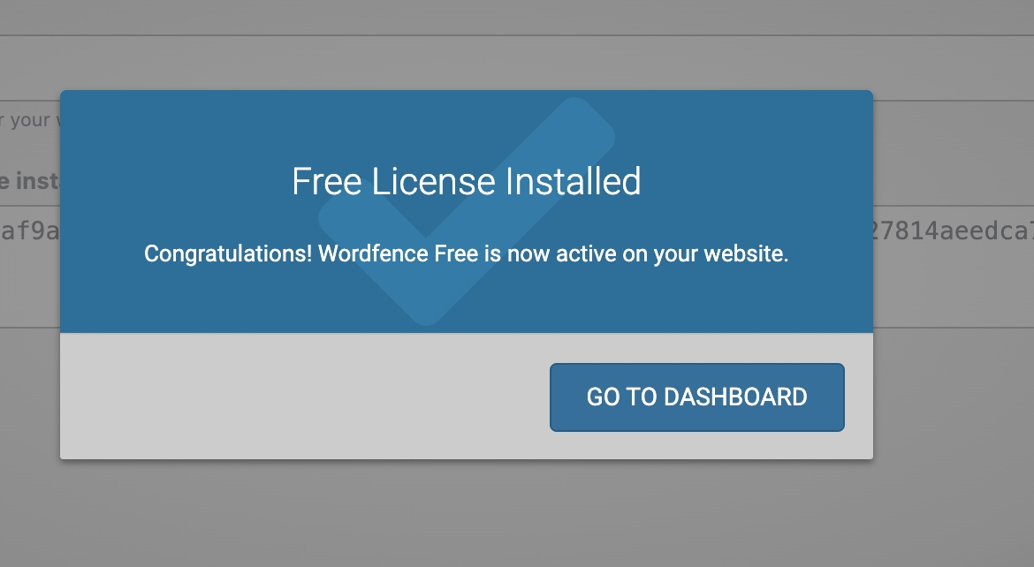
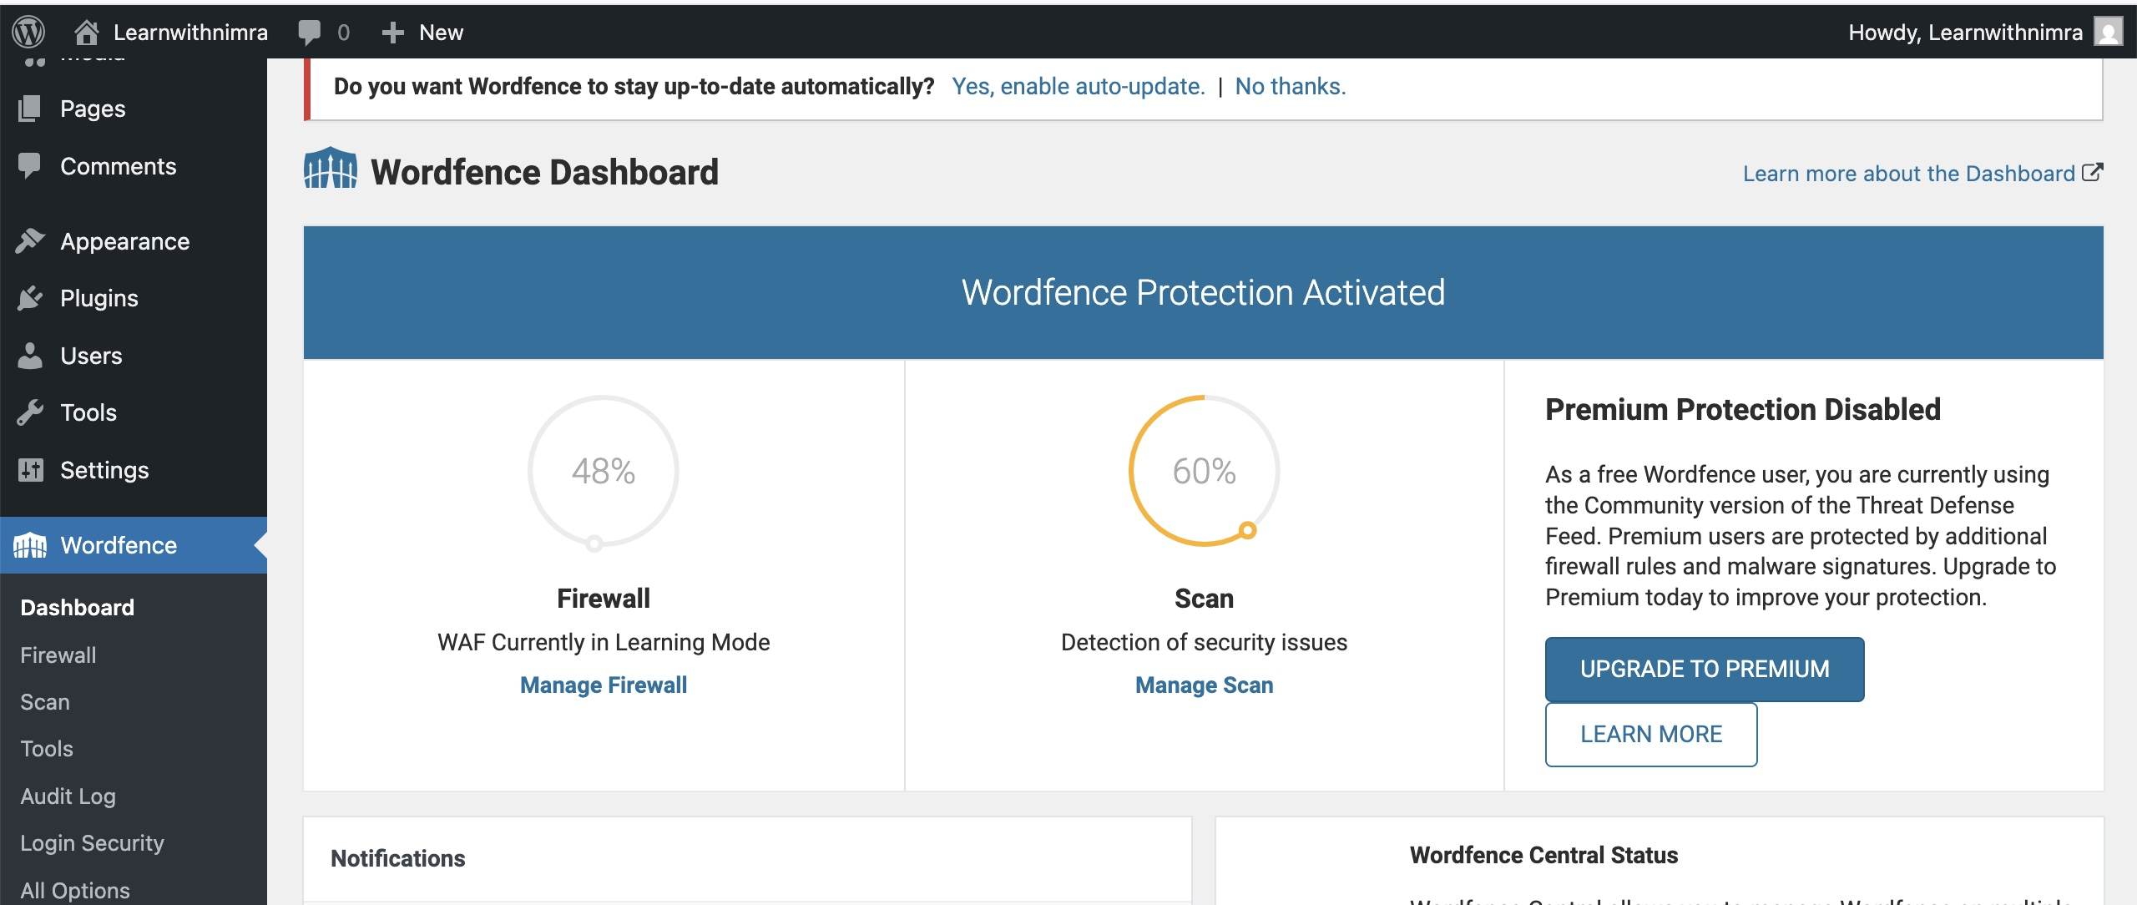
Step 5
Successfully Activated

Slide 23
Installing Other Plugins

Slide 24
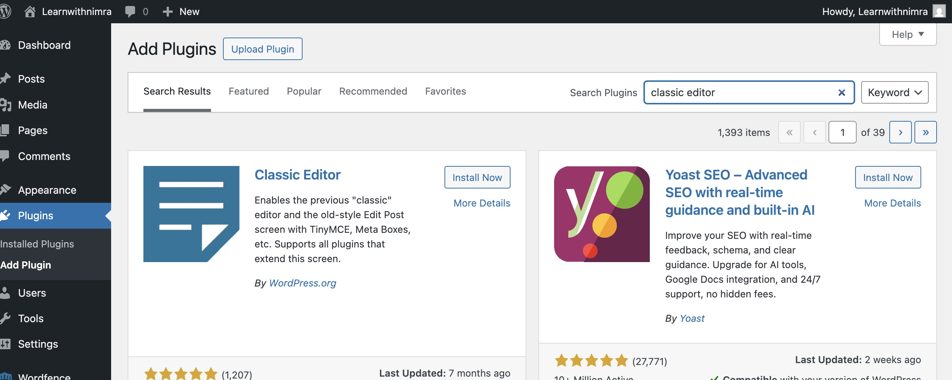
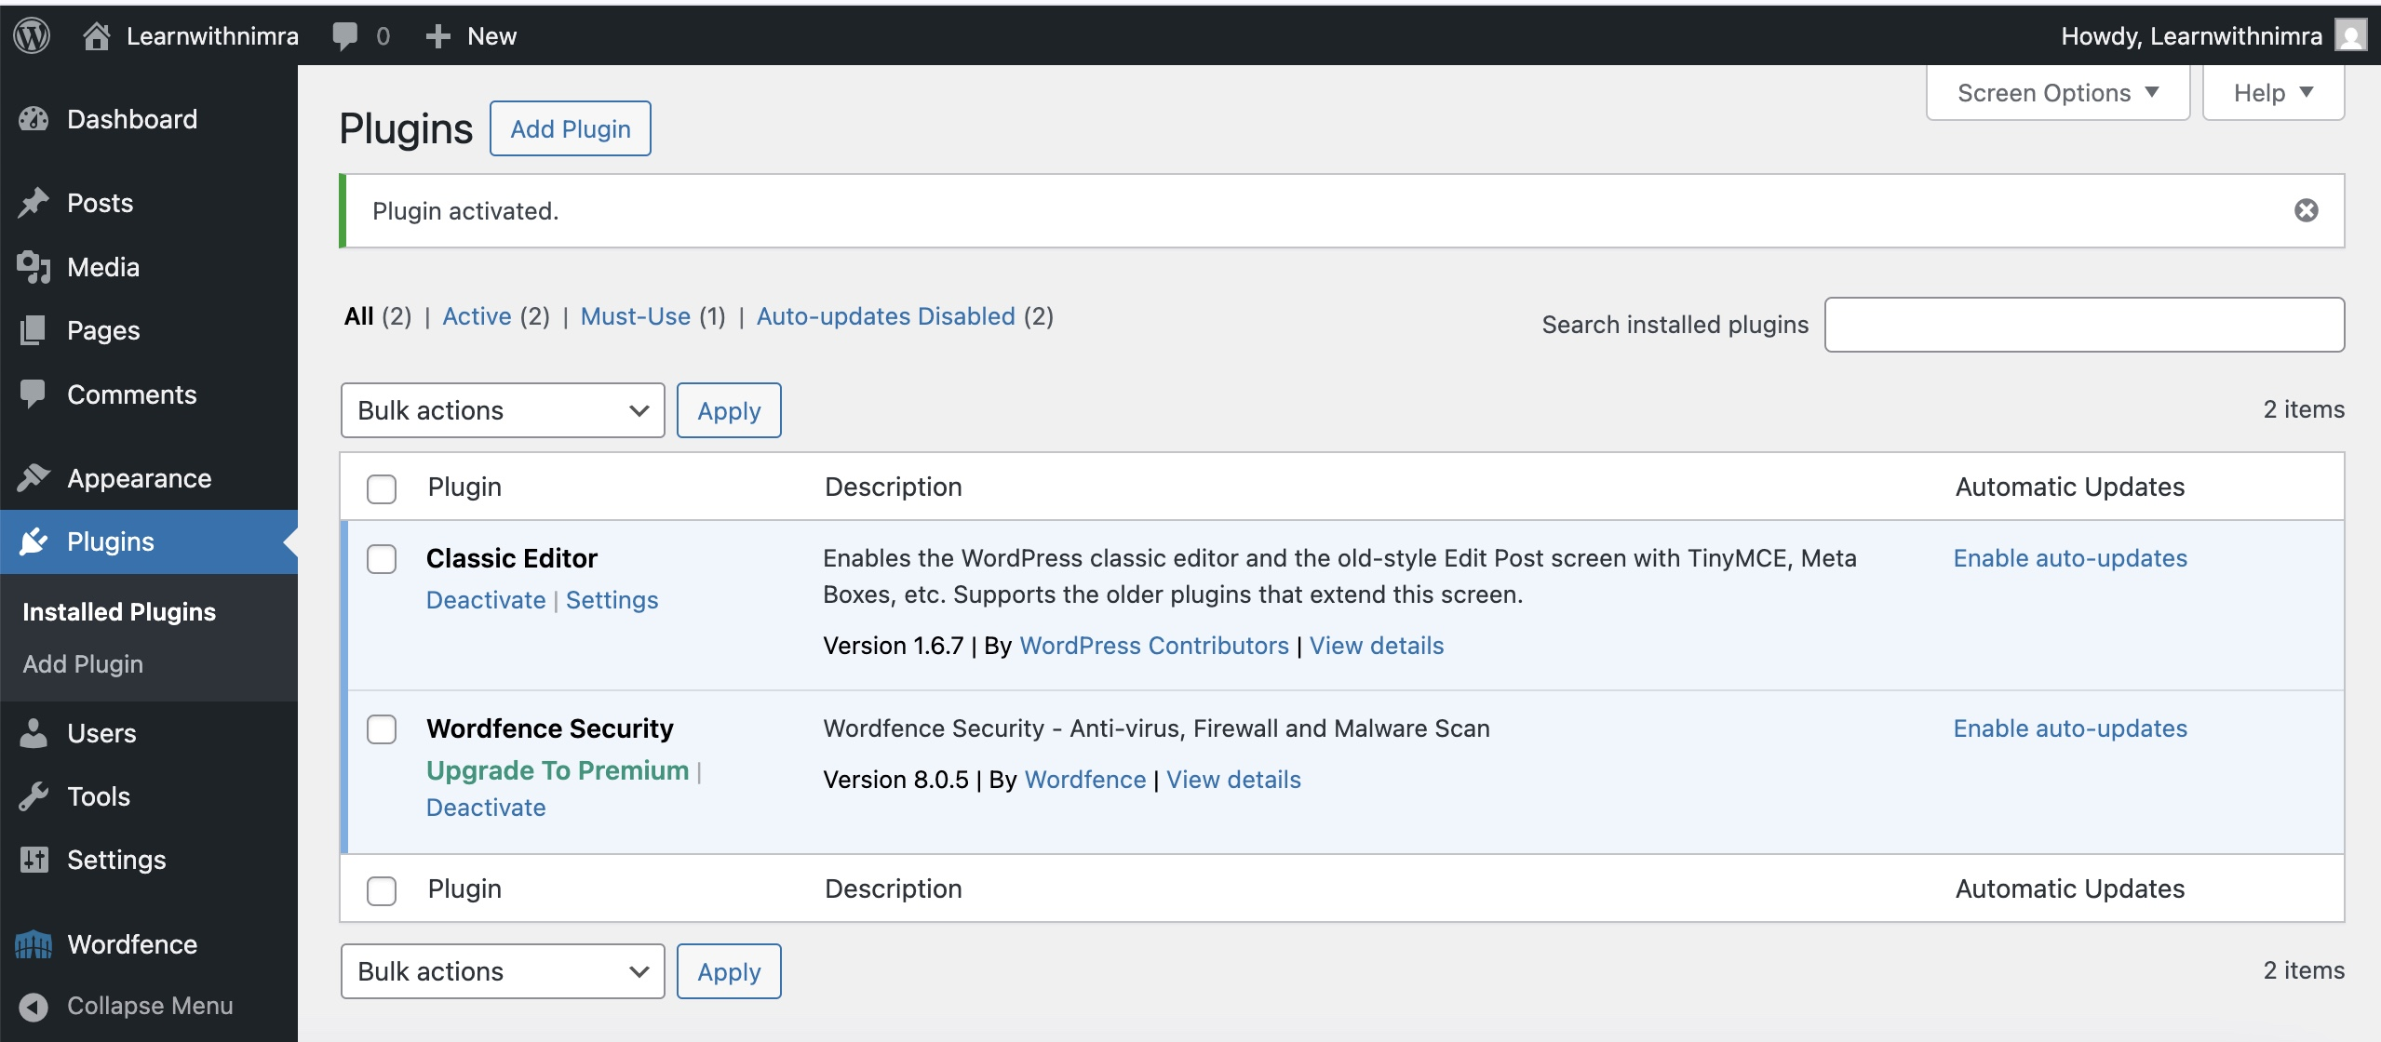
Install Classic Editor
In Plugins → Add New, search Classic Editor
Click Install Now, then Activate.

Slide 25
Creating your Own Website

Slide 26
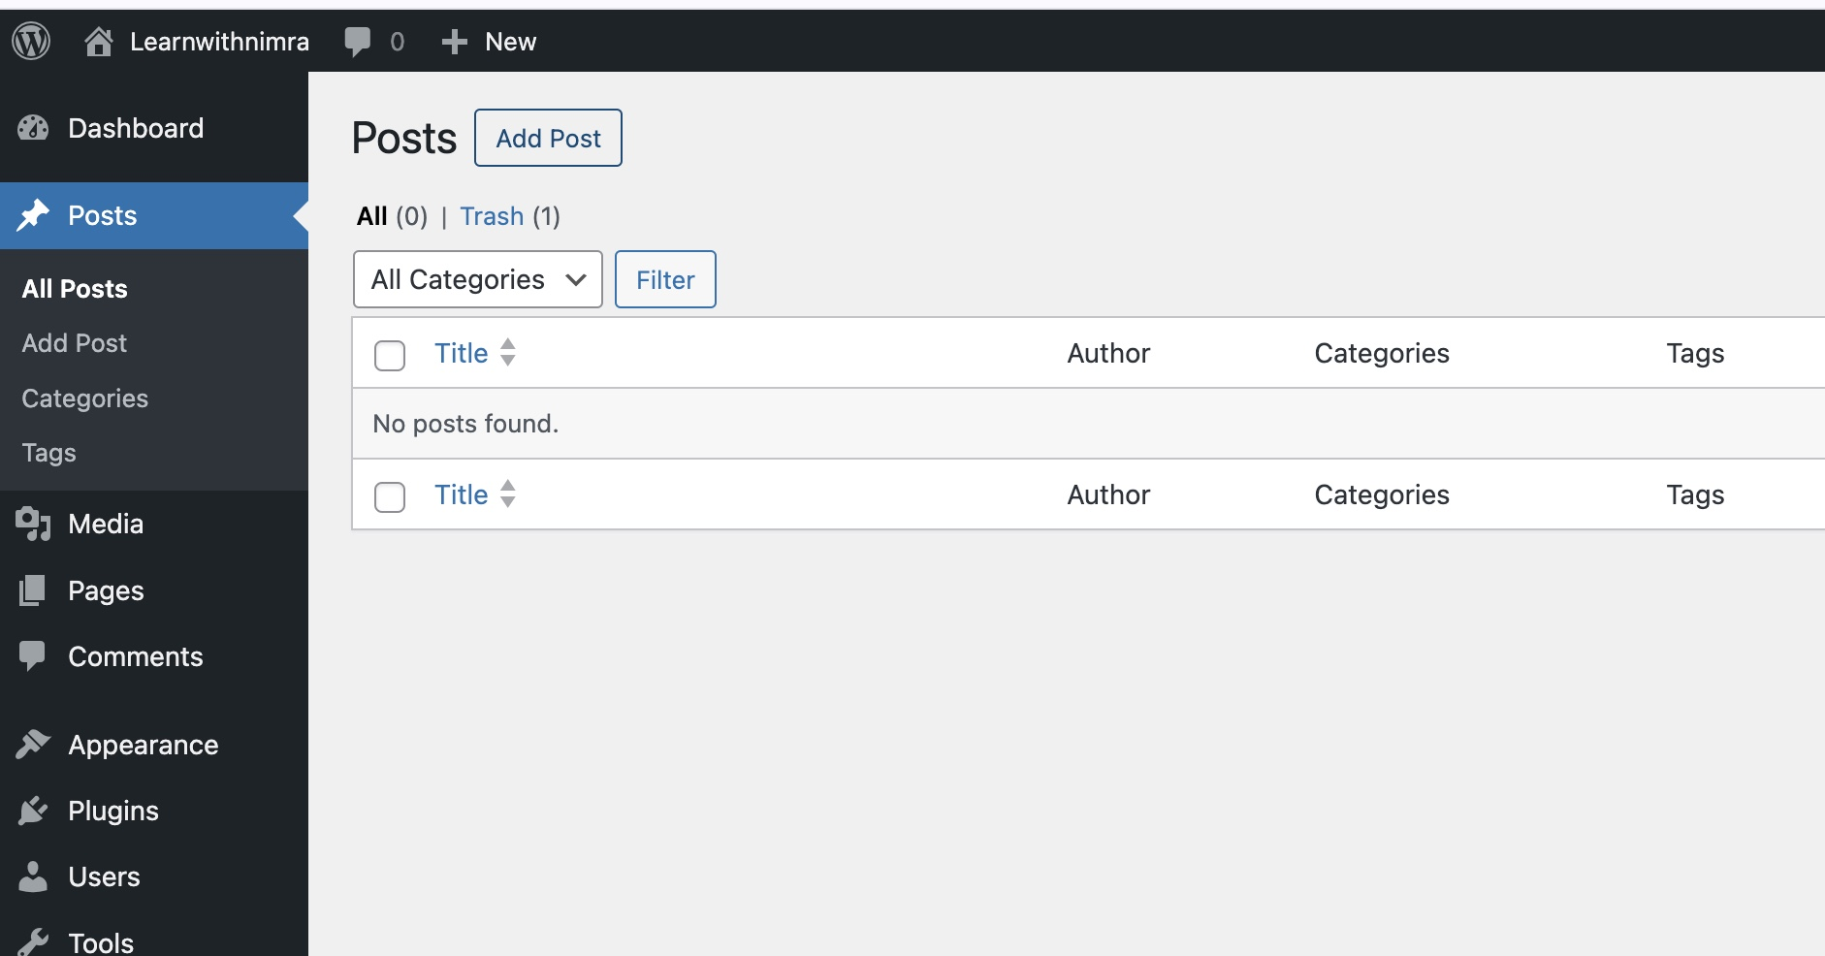
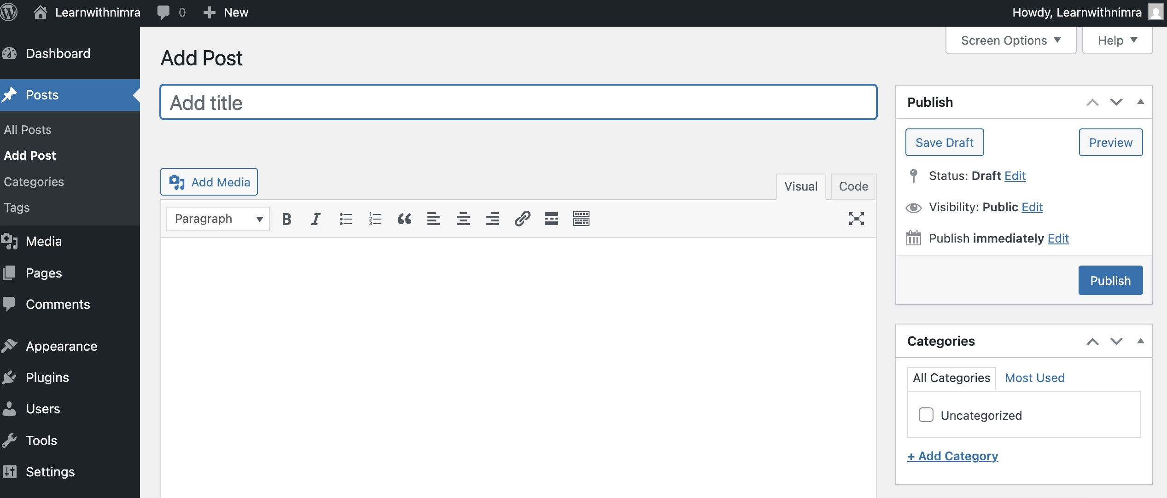
Customize Your Site
With security in place, proceed to content and theme customization
1.) Simple Post
In Posts → Add New, enter a title and content
Click Publish to make it live

Slide 27
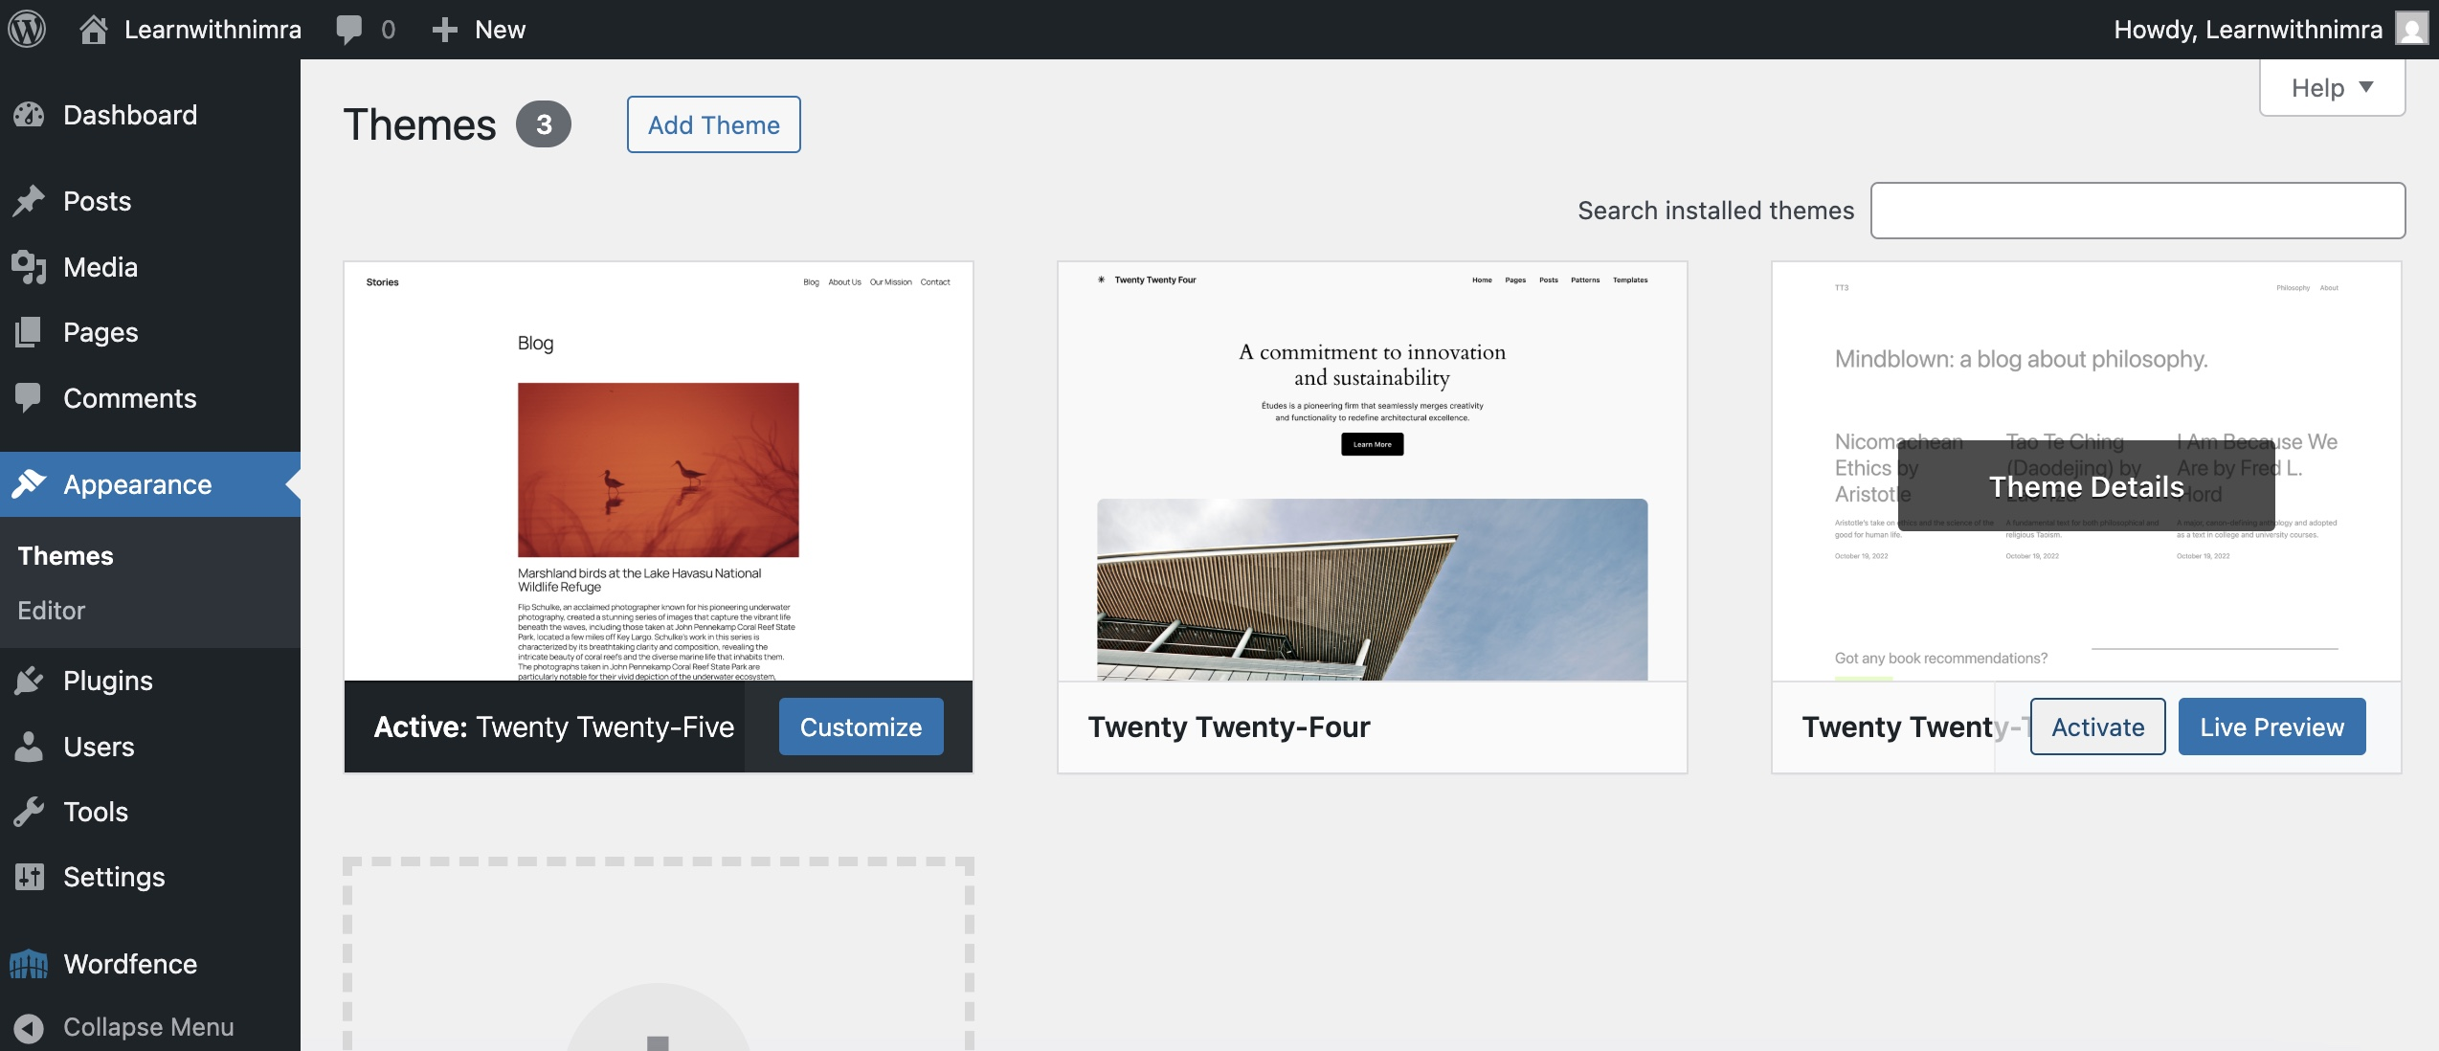
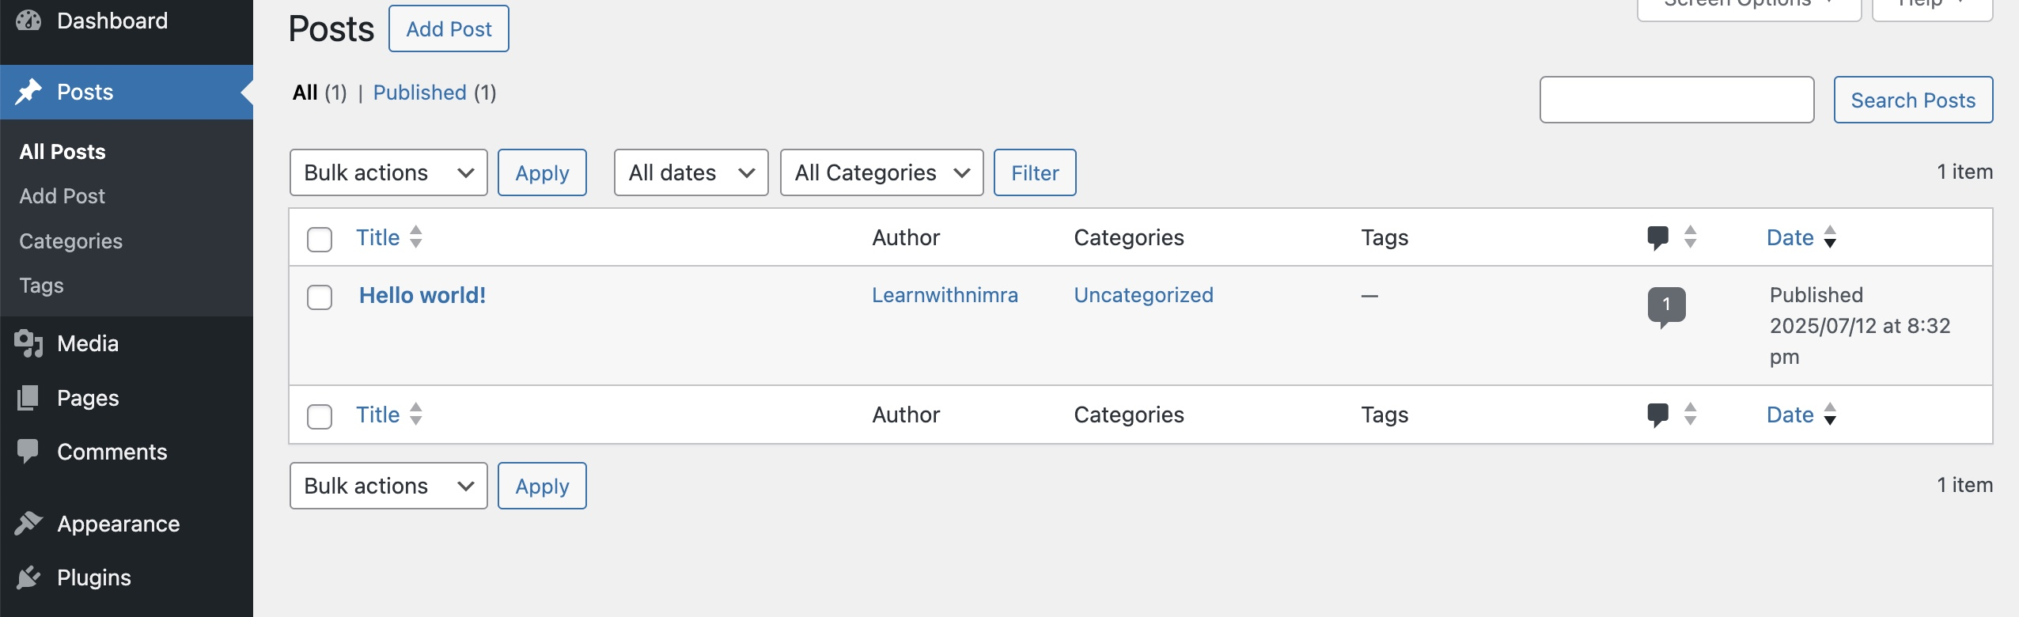
2.) Change Theme
Go to Appearance → Themes
Activate the Twenty Twenty-Three theme
Visit Posts → All Posts to see the default “Hello World” post
Trash it or edit as needed

Slide 28
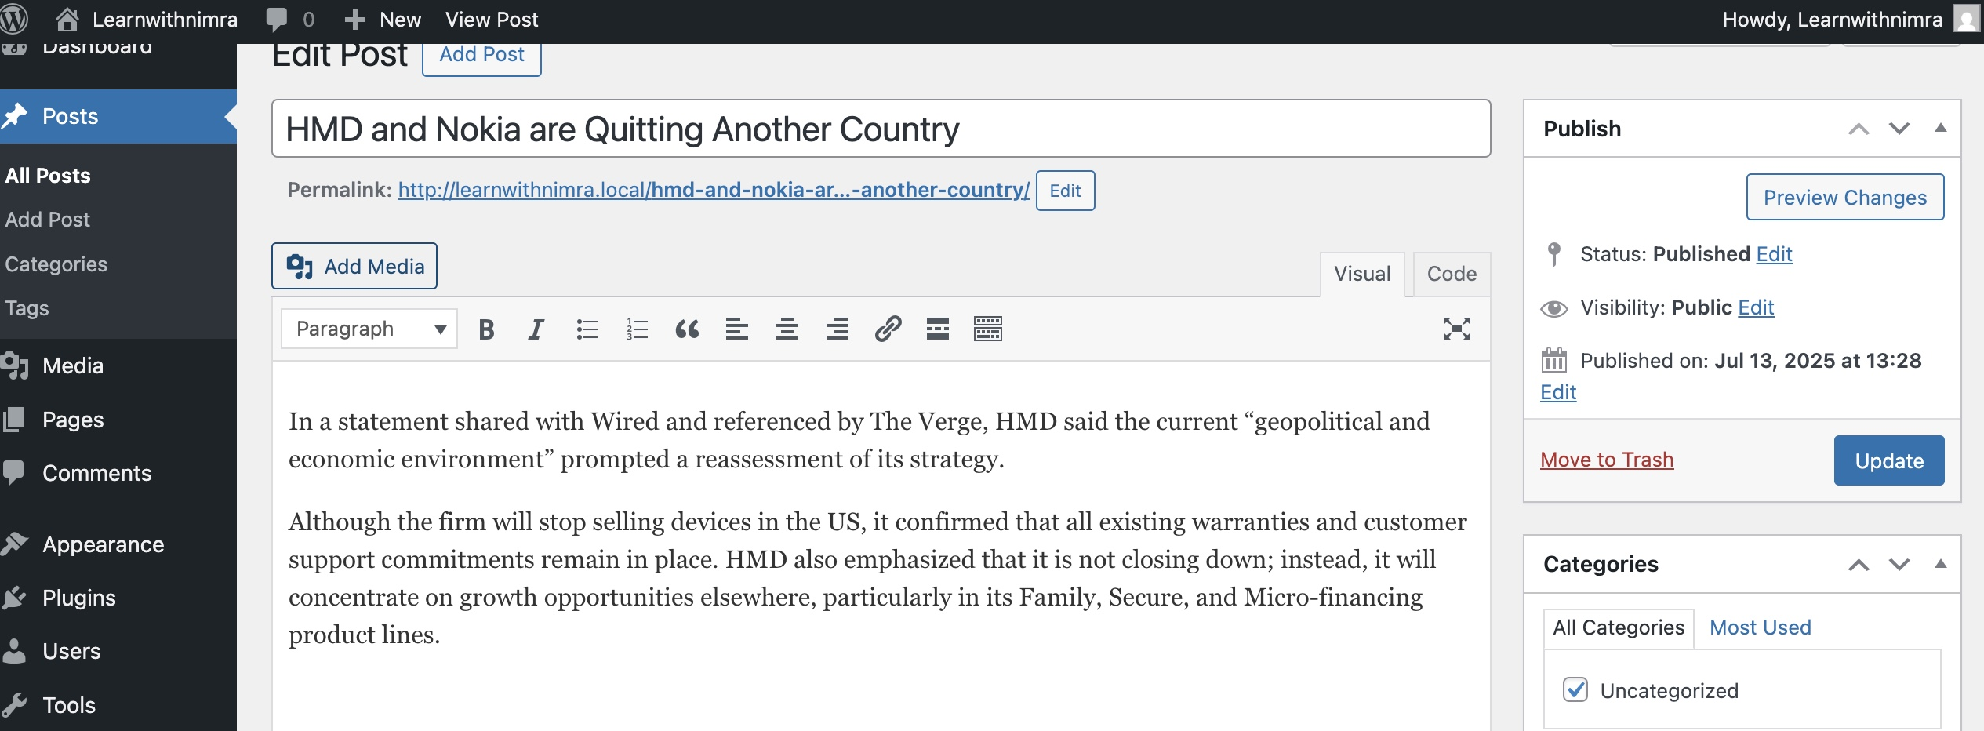
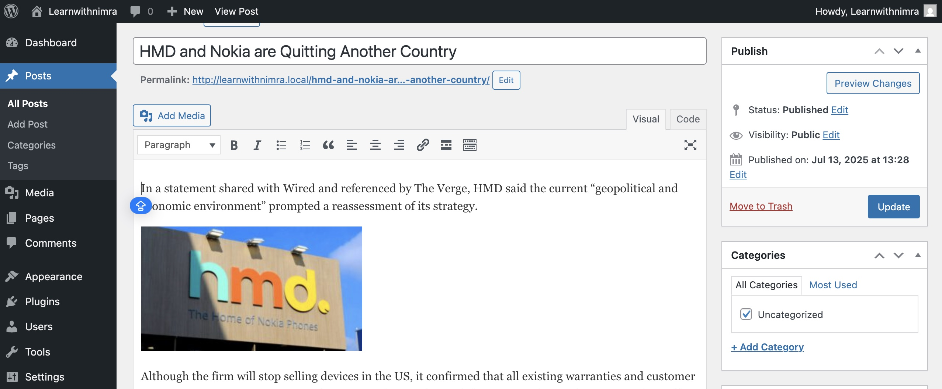
3.) Simple Post with Image
Save your image locally
Edit an existing post or create a new one
Click Add Media, upload your image, then Update

Slide 29
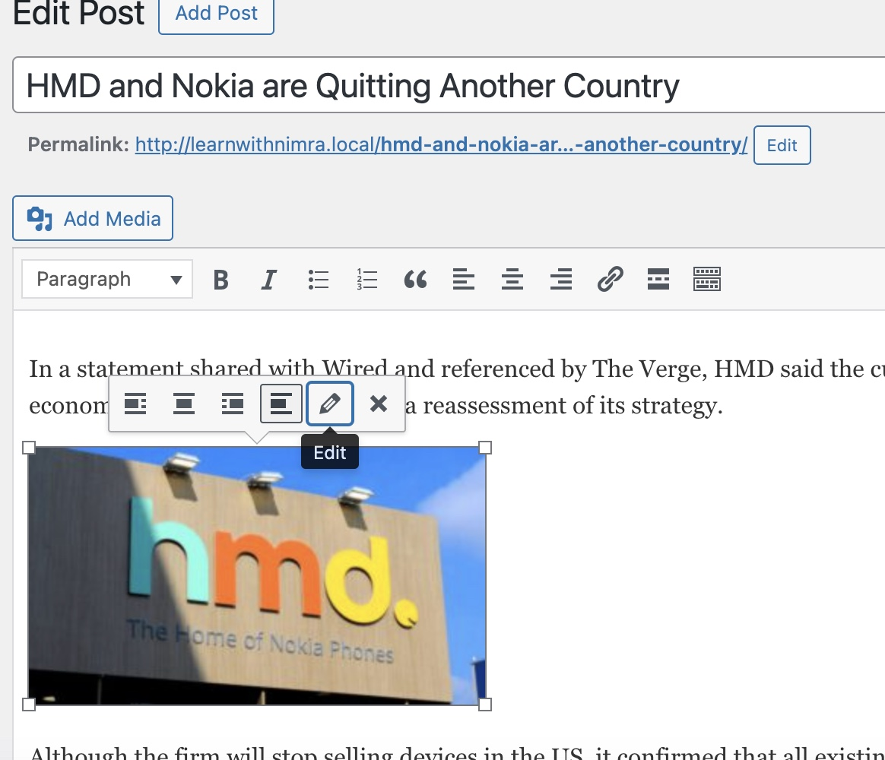
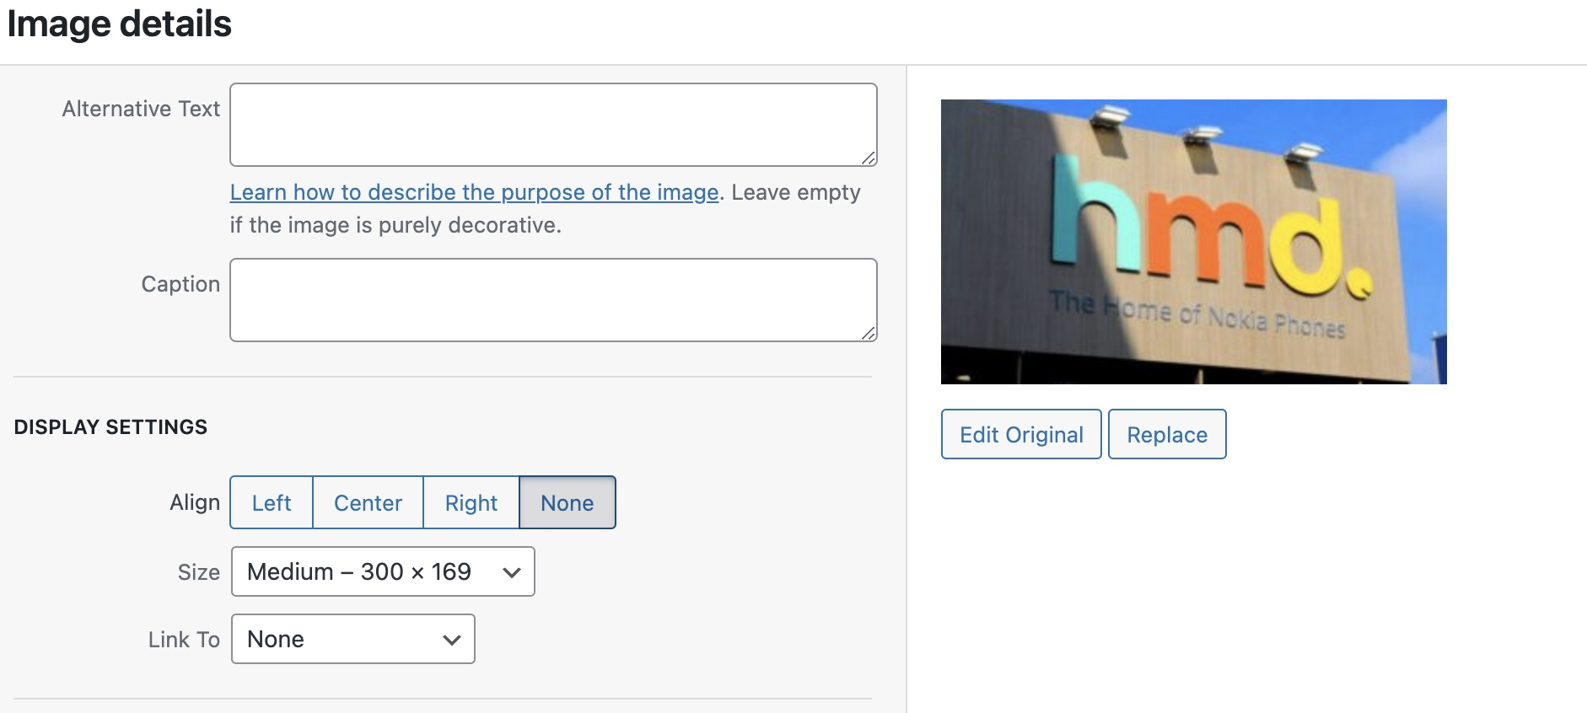
Resize Image
To resize, click the image in the editor, choose Edit, and adjust dimensions

Slide 30
4.) Simple Post with Video
Best practice: host video on YouTube to save space.
Copy the YouTube link
In the post editor, paste the link where you want the video
Click Update to embed and publish
Copyright Reminder
Always use original content or properly licensed media.
Avoid copying other sites’ material to prevent legal issues and blacklisting.
Use tools like ChatGPT for drafting unique content.h

Slide 31
Posts
All Posts: View, edit, or trash existing posts Add New: Create a new blog post Categories & Tags: Organize content for easy navigation
Media
Library: Browse and manage images, videos, and files Add New: Upload new media items Edit Details: Modify metadata, captions, alt text, and file names
WordPress Dashboard Overview
Pages
All Pages: View, edit, or delete static pages Add New: Create landing pages or site sections Quick Edit: Change title/slug/status without opening the editor
Comments
Moderation Queue: Approve, reply, or mark comments as spam Comment Settings: Control who can comment and when Bulk Actions: Quickly manage multiple comments at once
Let’s Explore all this from the Dashboard !

Slide 32
Appearance
Themes: Install, preview, and activate new themes Customize: Live-preview site settings like colors, header, and widgets Widgets & Menus: Add sidebar content and configure navigation Theme Editor: (Advanced) Edit theme files directly
Plugins
Installed Plugins: Activate, deactivate, update, or delete plugins Add New: Search the WordPress repository for functionality extensions Plugin Settings: Access individual plugin configuration pages
WordPress Dashboard Overview
Let’s Explore all this from the Dashboard !
Users
All Users: View and edit user profiles and roles Add New: Invite new contributors, editors, or administrators Your Profile: Update personal details, password, and editor preferences

Slide 33
Tools
Import/Export: Move content in and out of your site Site Health: Check diagnostics and recommended improvements Export Personal Data: Comply with data requests
Settings
General: Site title, tagline, URL, and email address Writing & Reading: Configure default post settings and front page display Discussion: Manage comment policies and moderation rules Media: Define image sizes and organization Permalinks: Customize URL structures Privacy: Set your privacy policy page
WordPress Dashboard Overview
Let’s Explore all this from the Dashboard !
Users
All Users: View and edit user profiles and roles Add New: Invite new contributors, editors, or administrators Your Profile: Update personal details, password, and editor preferences

Slide 34

Understanding WordPress Themes
Free Themes
Limited customization options
No demo content
Average design quality
Pro Versions of Free Themes (Paid Upgrades)
Expanded customization options
Occasional demo content imports
Average design quality
Starter templates in some cases
Premium Themes
Fully paid, professional themes
Extensive customization controls
Superior design quality
Bundled premium plugins/features
One-click demo installer
Plug-and-play functionality

Slide 35

Understanding WordPress Themes
Premium Theme Marketplaces
ThemeForest.net: Largest marketplace with thousands of premium themes
Top Seller: Avada – versatile, feature-rich, highly customizable
Introducing Elementor
In Plugins → Add New, search Elementor
Click Install Now, then Activate
Add New Page → Click Edit with Elementor
Next Steps
Experiment with Elementor templates and global styles
Explore advanced widgets: Forms, Sliders, and Popups
Review Elementor documentation and community tutorials

Slide 36

Do you have any questions?

